Slide 1
Additional Topics in Web Crawling
Timothy Bruce

Slide 2
Purpose of Presentation
Review of basic web crawler design.
Learn about use cases for web crawlers that are not specifically for the creation of a general purpose search engine.
Start thinking about alternative methods of creating web crawlers using approaches suggested in academic articles.
Compare several general purpose web crawlers.

Slide 3
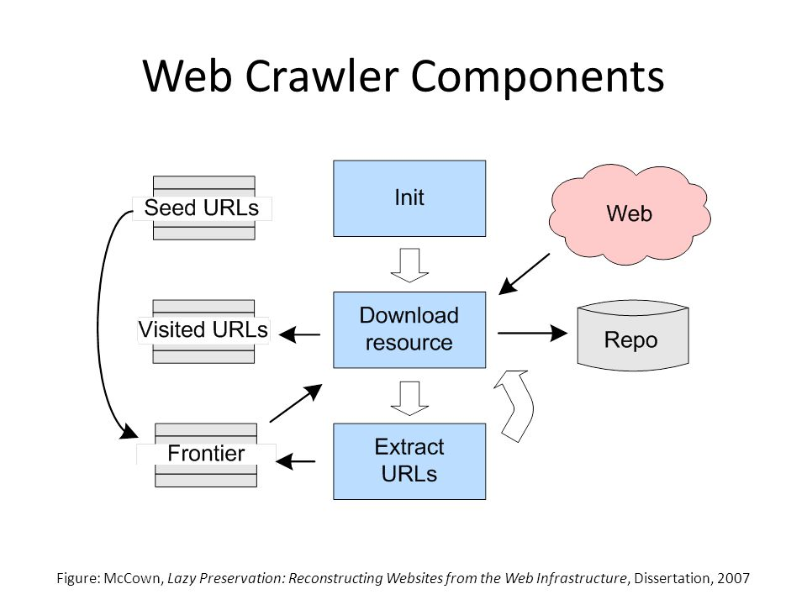
Review

Slide 4
Alternative Uses for Web Crawlers
Focused Web Crawler
Prioritizes items on the frontier based on how relevant it thinks the item will be to the focus that it is pursuing.
Needs to predict how relevant a page is going to be using some kind of parser from the page where it got the link.
Type or Topic.
Focused crawlers could be used for:
Journalism – Similar to the Local Memory Project
Recent History
Perception Analytics (for a product or company)
Creating a database of all blogs
Notes:
Journalism – Keeping up to date on a breaking story from all sources.
Recent History – Searching for all different internet records of an event.
Perception Analytics – Finding all references to something and determining the positivity of how it is being referred to.
Article: Sentiment-Focused Web Crawling
Article: Local Memory Project

Slide 5
Seed URL Database Creation
An approach for selecting seed URLs of focused crawler based on user-interest ontology by YaJun Du, et al.
Input
Multi-Dimensional Vector for interest in topics.
User generated example queries.
Output
Generate seed URIs for focused crawlers.
Method
Searching Google for results to the queries.
Making the topics of the results into a vector.
Comparing the results to the user interest vector.
Notes:
Article: An approach for selecting seed URLs of focused crawler based on user-interest ontology

Slide 6
Keeping Data Fresh
Once a database is created, websites will update from time to time.
An updated website may include:
New Links
New Information About Links
New Content
Updated Existing Content
A study done by Chungbuck National University in South Korea found that using a simple “dynamic web crawling scheduler” could improve performance by up to 59%.
If(notUpdatedYet){ lengthenTimeBetweenUpdates(); }
Notes:
Article: Design and Implementation of Web Crawler Based on Dynamic Web Collection Cycle
This is the Kim article

Slide 7
Characteristics of various web crawlers
In 2005 The University of Cyprus did a study of four general search crawlers characteristics across five websites and compared them to normal traffic.
They found that people were much more capable of finding 2xx codes rather than 3xx, 4xx, and 5xx.
The researchers suggest caching bad links could significantly reduce crawler traffic on the server side, and increase performance.
They also suggest using “intelligent techniques” to help avoid 4xx codes, but do not suggest methods of implementing these.
Notes:
Article: An investigation of web crawler behavior: characterization and metrics

Slide 8
Works Cited
A. Gural Vural, B. Barla Cambazoglu, and Pinar Karagoz. 2014. Sentiment-focused web crawling. ACM Trans. Web 8, 4, Article 22 (October 2014), 21 pages.
Alexander C. Nwala, Michele C. Weigle and Michael L. Nelson and Adam B. Ziegler and Anastasia Aizman. 2017. Local Memory Project. In Proceedings of Joint Conference on Digital Libraries, Toronto Ontario, Canada, June 2017 ( JCDL’17), 10 pages.
K.S. Kim, K.Y. Kim, K.H. Lee, T.K. Kim, and W.S. Cho. 2012. Design and implementation of web crawler based on dynamic web collection cycle. The International Conference on Information Network 2012 (2012). DOI:http://dx.doi.org/10.1109/icoin.2012.6164440
Marios D. Dikaiakos, Athena Stassopoulou, and Loizos Papageorgiou. 2005. An investigation of web crawler behavior: characterization and metrics. Computer Communications 28, 8 (2005), 880–897. DOI:http://dx.doi.org/10.1016/j.comcom.2005.01.003
Yajun Du, Yufeng Hai, Chunzhi Xie, and Xiaoming Wang. 2014. An approach for selecting seed URLs of focused crawler based on user-interest ontology. Applied Soft Computing 14 (2014), 663–676. DOI:http://dx.doi.org/10.1016/j.asoc.2013.09.007

